Slide 1

World Happiness Report

Slide 2

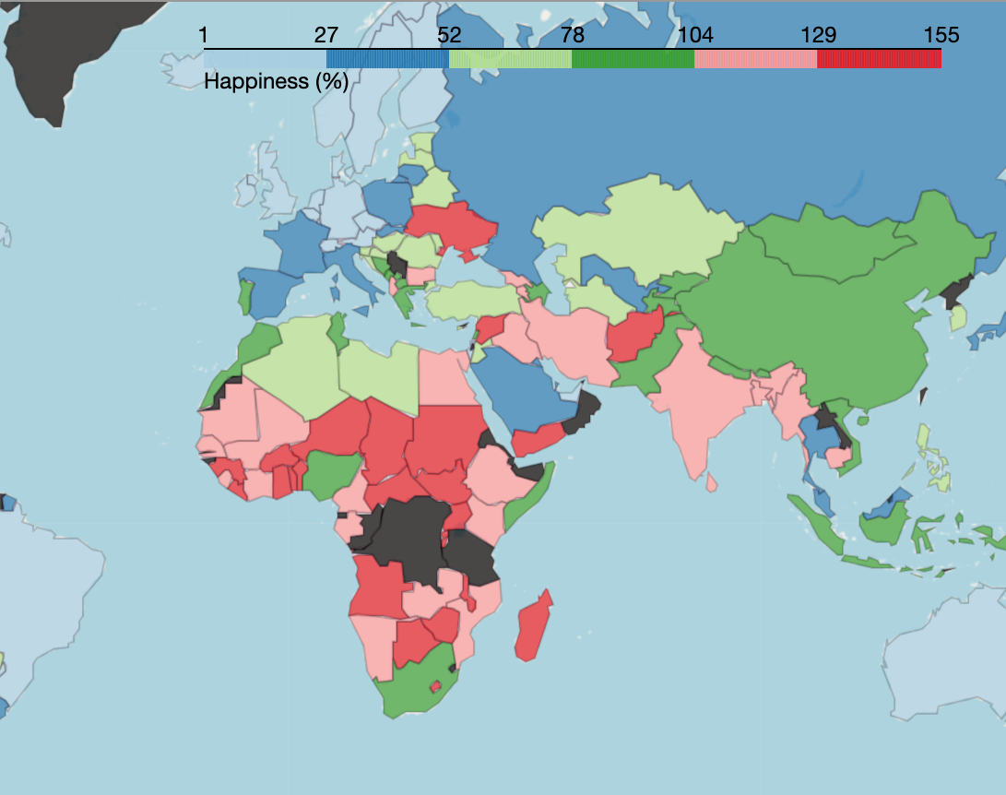
Happiness Index (or "Life ladder")
Did you know countries are ranked each year based on a Happiness Index? This index rates the happiness of countries on a scale from 0 to 10.
Today, we are going to face some facts and break some myths about Happiness and what we may think can make us happy.

Slide 3
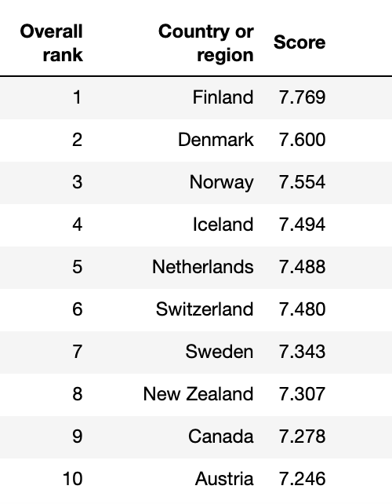
Top 10 Happiest Countries 2019
In 2019, the Gallup World Poll included Happiness Index data in 156 countries.
According to the Happiness Index of 2019, the happiest countries in the world are:

Slide 4
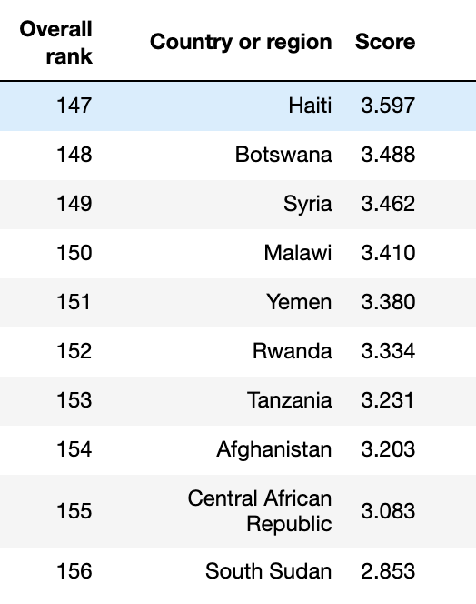
The 10 Unhappiest Countries 2019

Slide 5
Does Money Buy Happiess?
What is your prediction?

Slide 6
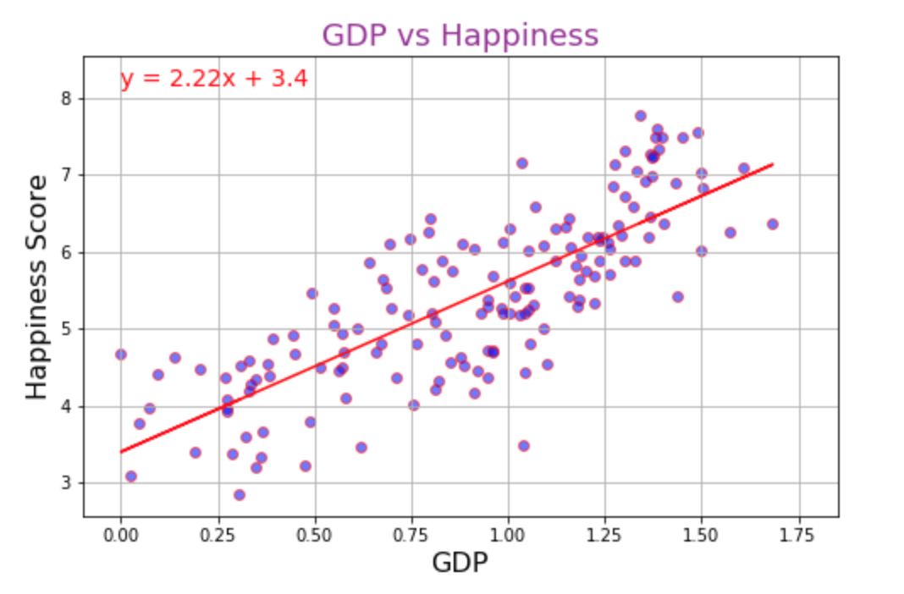
Money buys happiness up to a certain degree r-squared is: 0.794 p-value is: 4.3153e-35
GDP per capita
Gross Domestic Product - or GDP - is simply the value of all the goods and services a country produces on a yearly basis.
Divide the GDP by the total population of a country and you have the GDP per capita.
This is arguably the most accepted method of determining a country's level of wealth.
The wealth of a country is significantly correlated to its Happiness Index.

Slide 7
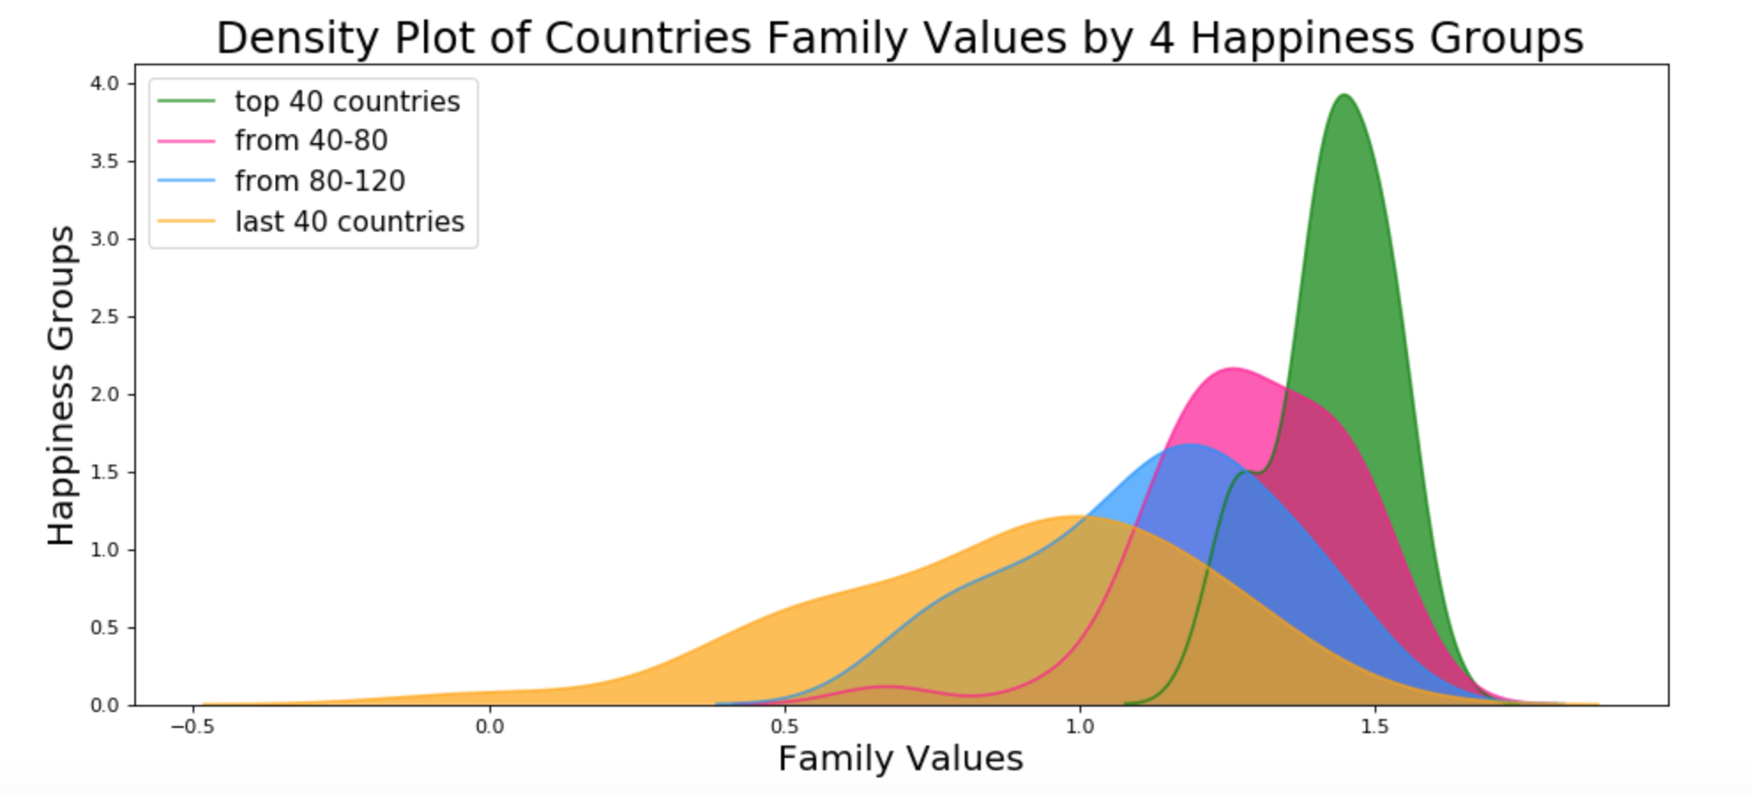
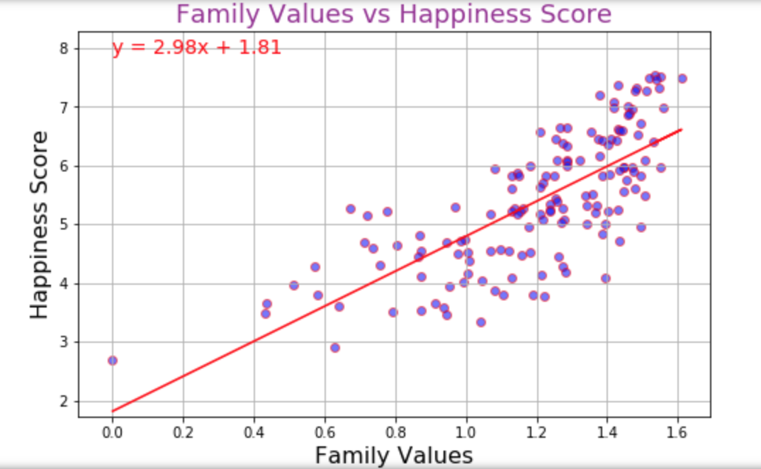
Family Values r-squared is: 0.742 p-value is: 8.109e-27 We divide all countries into 4 groups, based on the Happiness Index. The happiest countries are consistent with the highest family values.

Slide 8
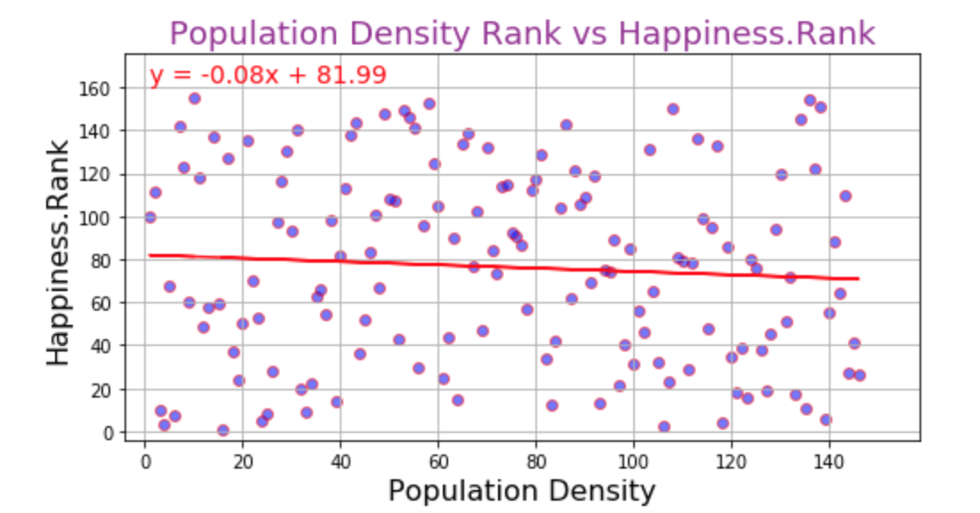
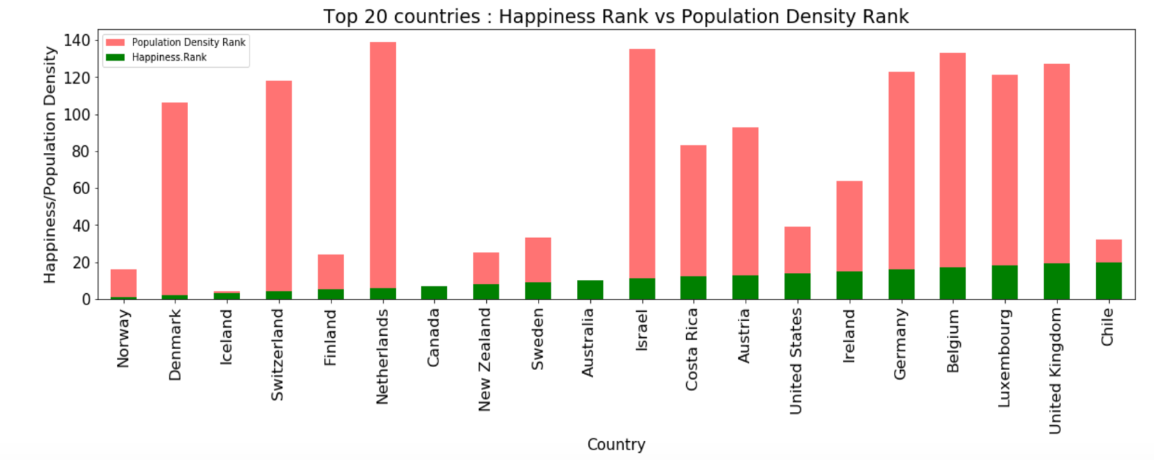
Population Density r-squared is: -0.073 p-value is: 0.382

Slide 9
Does Elevation Correlate to Happiness?
What is your prediction?

Slide 10
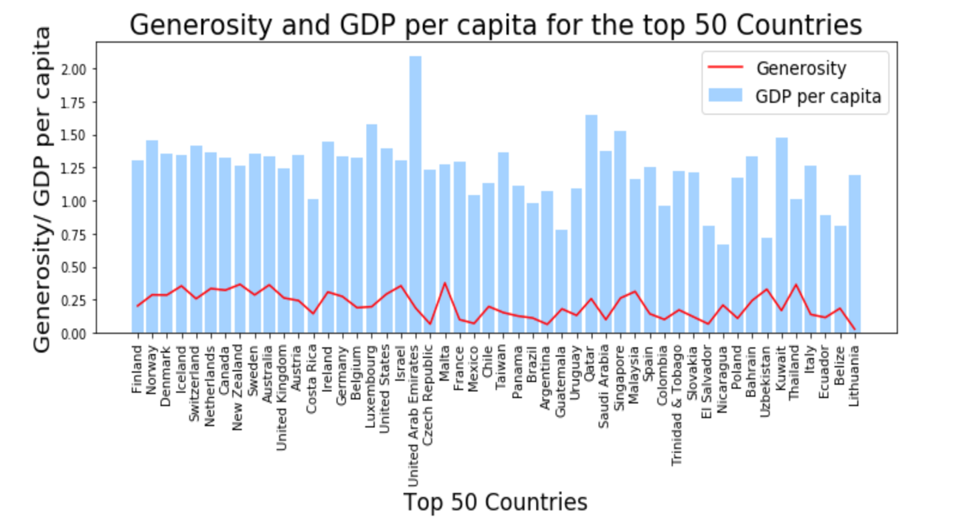
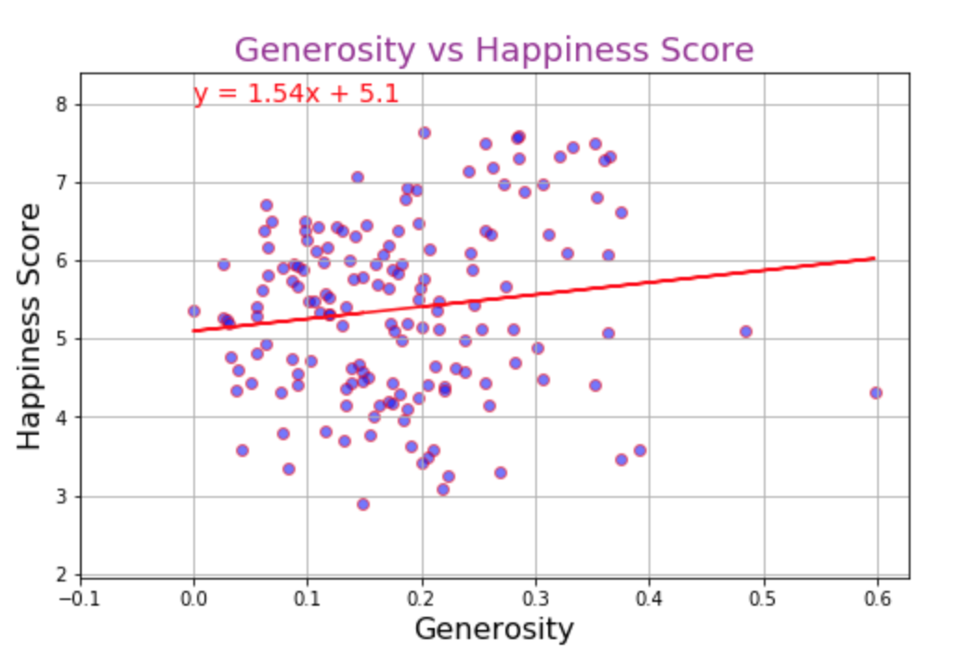
Generosity r-squared is: 0.136 p-value is: 0.091

Slide 11
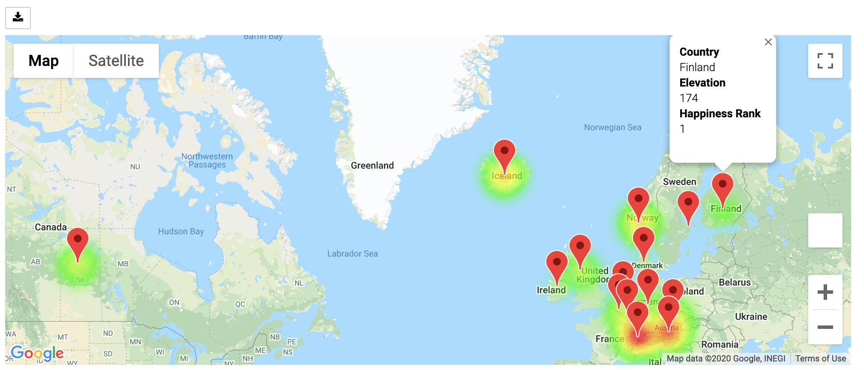
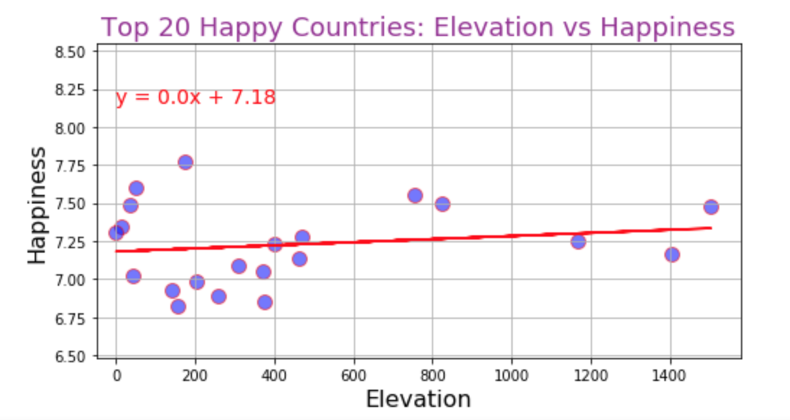
Elevation r-squared is: 0.1706 p-value is: 0.459

Slide 12
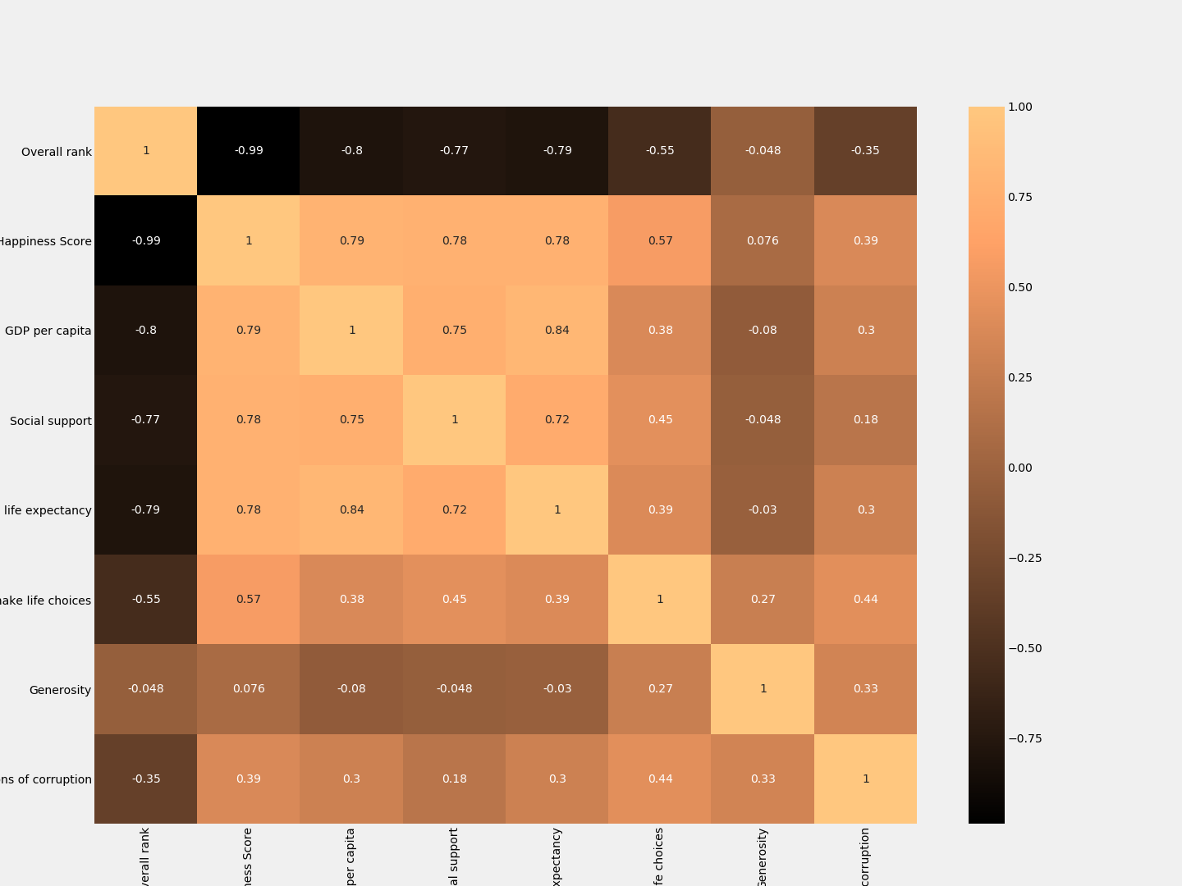
World Happiness Report Correlations 2019

Slide 13
Does Prevalence of Mental Illness Affect Happiness?
What is your prediction?

Slide 14
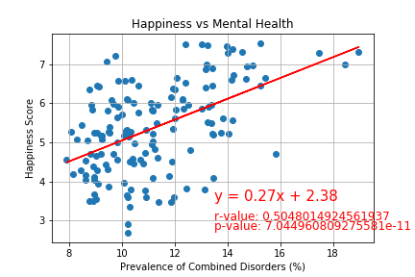
Results:
Mental Health is an aggregate of prevalence of :Schizophrenia, Bipolar disorder, Eating disorders, Anxiety disorders, Drug use disorders, Depression, and Alcohol use disorders.
Data taken from 2017
Conclusion: positive correlation! Why?
Sources: (https://www.kaggle.com/unsdsn/world-happiness); (https://ourworldindata.org/mental-health)

Slide 15
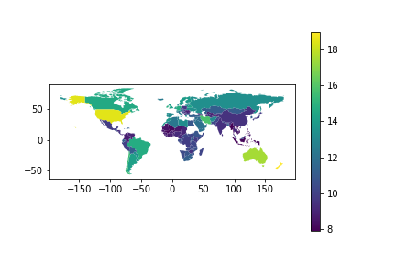
Chorograph of Mental Illness Prevalence

Slide 16
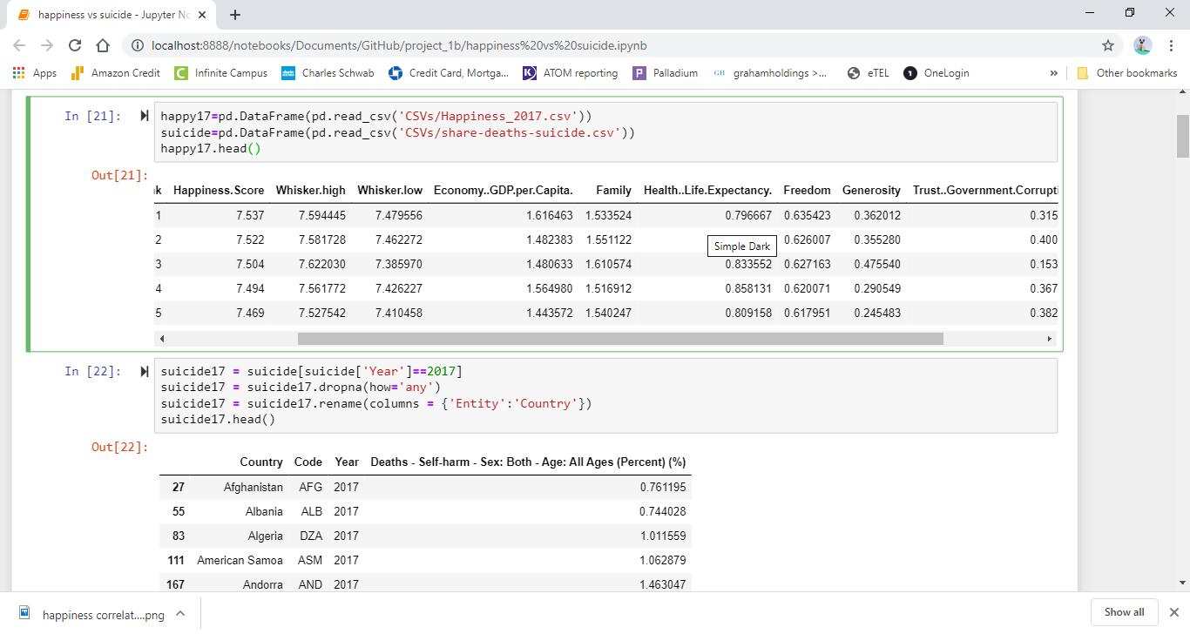
Data Cleanup ...

Slide 17
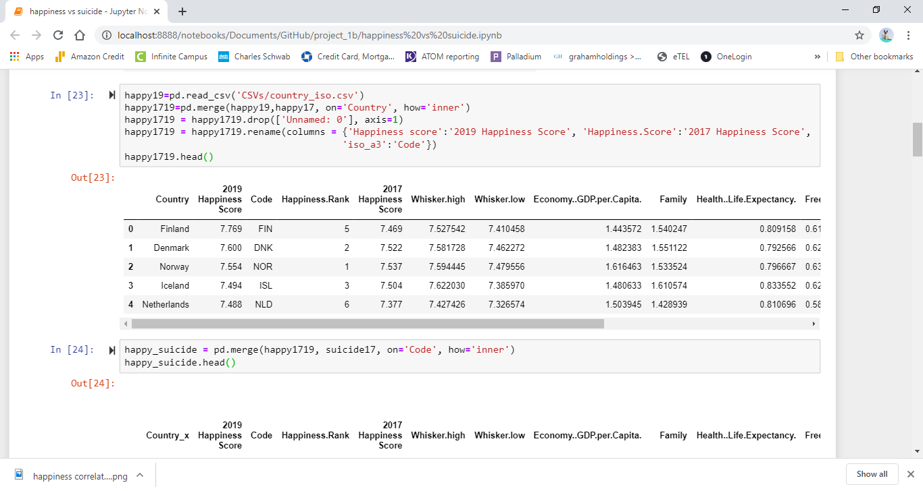
More Cleanup ...

Slide 18
Do Suicide Rates Influence Happiness?
What is your prediction?

Slide 19
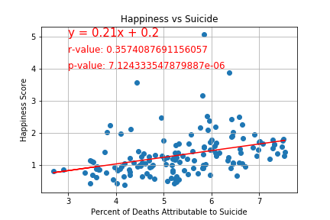
Results:
What factors influence suicide rate?
Sources: (https://www.kaggle.com/unsdsn/world-happiness); (https://datahub.io/core/country-codes#pandas);
(https://ourworldindata.org/suicide#suicide-is-a-leading-cause-of-death-especially-in-young-people)

Slide 20
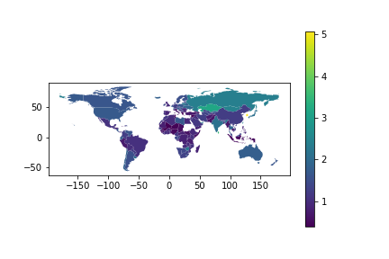
Chorograph of Suicide Rates

Slide 21
Do Crime Rates Correlate to Happiness?
What is your prediction?

Slide 22
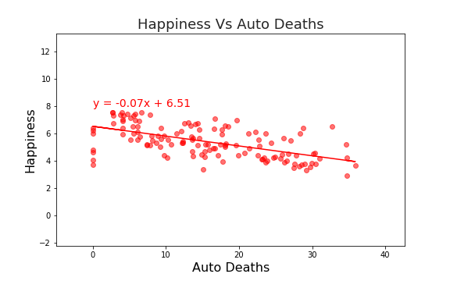
Happiness vs. Deaths from Auto Accidents
Hypothesis: Fewer deaths due to auto accidents will be correlated to happier people
p-value is: 1.105748e-13
r-squared is:-0.587
Conclusion: There is a negative correlation between auto deaths and happiness, supporting our hypothesis

Slide 23
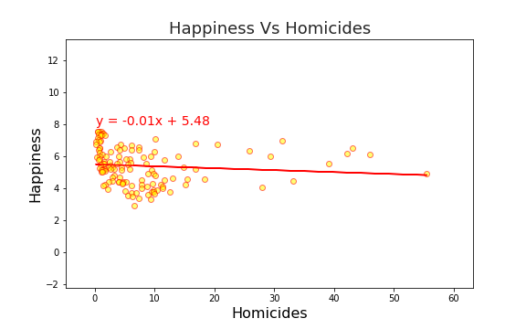
Homicide rate vs. Happines
Hypothesis: Lower homicide rates will be correlated with higher happiness scores
P-value: 0.2374
R-squared: -0.1031
Conclusion: Have to accept null hypothesis, no correlation between homicides and happiness

Slide 24
Does Access to Education Affect Happiness?
What is your prediction?

Slide 25
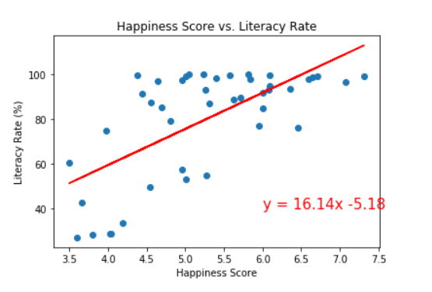
Happiness Score vs. Literacy Rates
Measures rate of literacy in different countries vs. overall happiness score
Pvalue = .00000145
Rvalue = .66
There is a moderate correlation between literacy and happiness showing that literate people tend to be happier

Slide 26
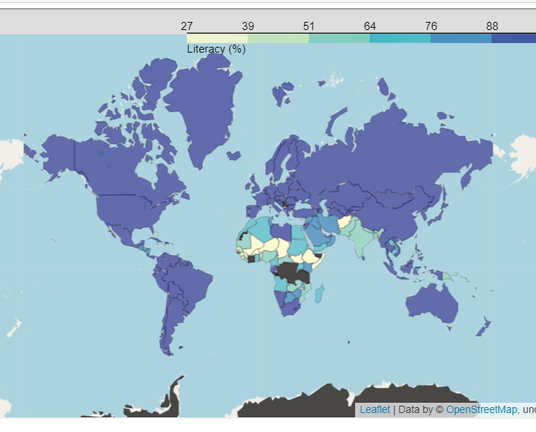
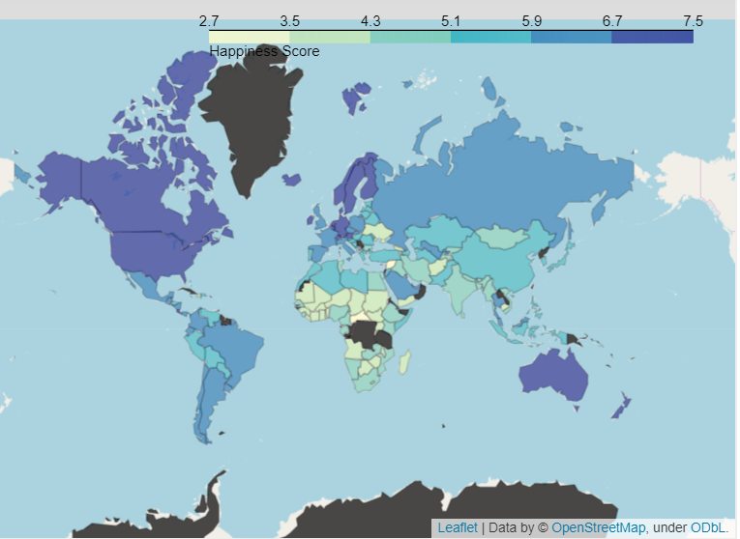
World Map – Literacy Rate by Country (left) World Map – Happiness Report by Country (right)

Slide 27
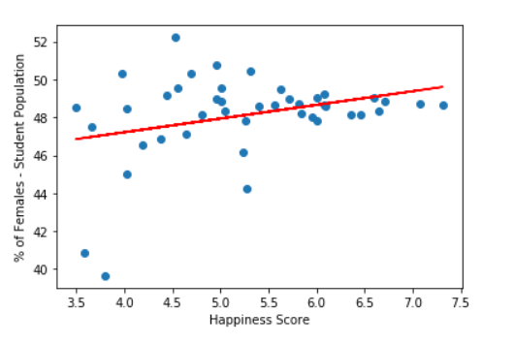
Happiness vs. Gender Equality in Education
This measures the percentage of student populations that are female vs. the overall happiness score of citizens
Pvalue = .039
Rvalue = .32
The correlation isn’t strong, but we can still reject our null hypothesis and say there is a correlation between gender equality in education and overall happiness

Slide 28
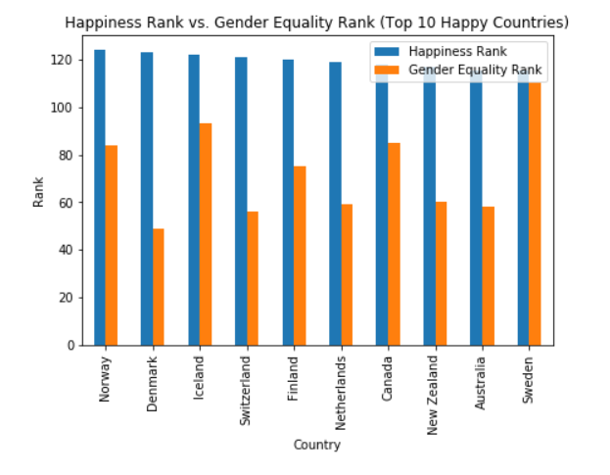

Slide 29
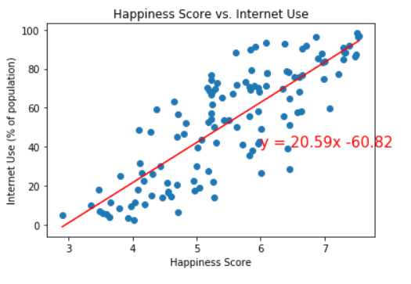
Happiness and Internet Use
Null hypothesis: No correlation between internet use and happiness
Pvalue: 6.610027640e-31
Rvalue: .82
Conclusion: strong correlation between percentage of people that use the internet and happiness levels

Slide 30
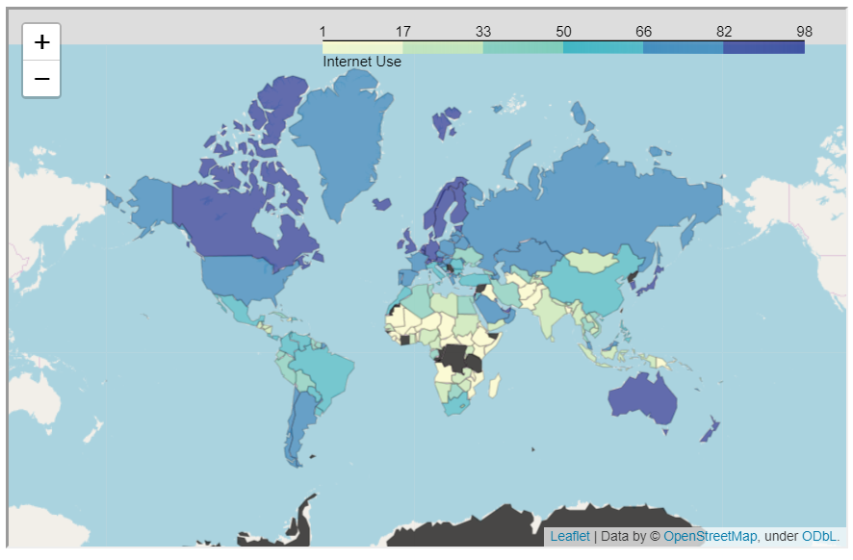
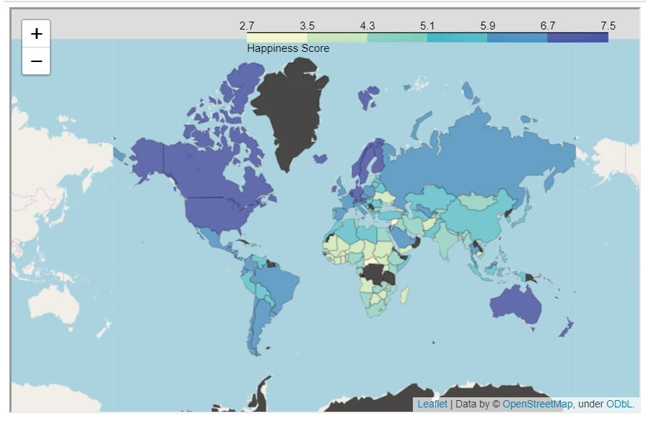
Internet Use (left) vs. Happiness Score (right)

Slide 31


Sometimes We Are Just Happy!

